Slide 1
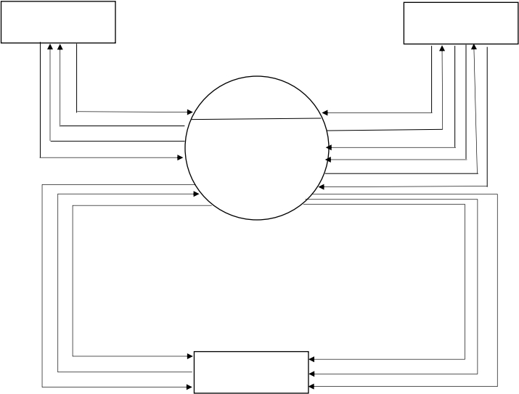
CODEWORK FREELENCER MANAGEMENT SYSTEM
CONTEX LEVEL DIAGRAM
FREELANCER
CLIENT
Request For Project
0.0
Make Inquiry
View Client Project
CODEWORK
Get Inquiry Reply
Success/Fail
Client Details
Freelancer Details
FREELANCER
Post Project
MANAGEMENT
Request For Project
SYSTEM
Accept/Denied
Client Information
ADMIN
Client Inquiry Details
Get Inquiry Reply
Client Registration Details
Freelancer Details
Client Project Details
[Date]
1

Slide 2
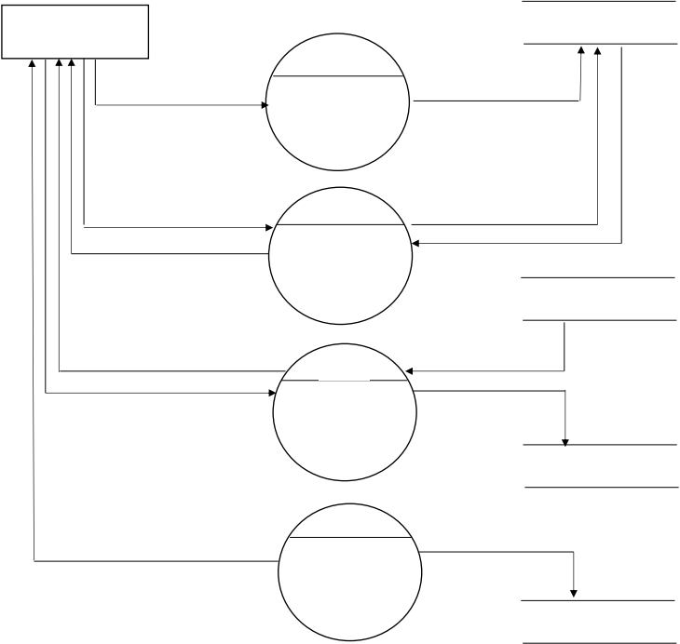
CODEWORK FREELENCER MANAGEMENT SYSTEM
FIRST LEVEL DIAGRAM FREELANCER
FREELANCER
FREELANCER
v
1.0
Registration Details
Registration
Registration Information
User ID & Password
2.0
Log In Information
Success & Fail
Success & Fail
Log In
POST_PRJ
View Project
3.0
Project Details
Registration details
Request For Project
Project Request
Registration details
View
Project
REQUEST_PRJ
4.0
Freelancer Feedback
Submitted
Feedback
FEEDBACK
[Date]
2

Slide 3
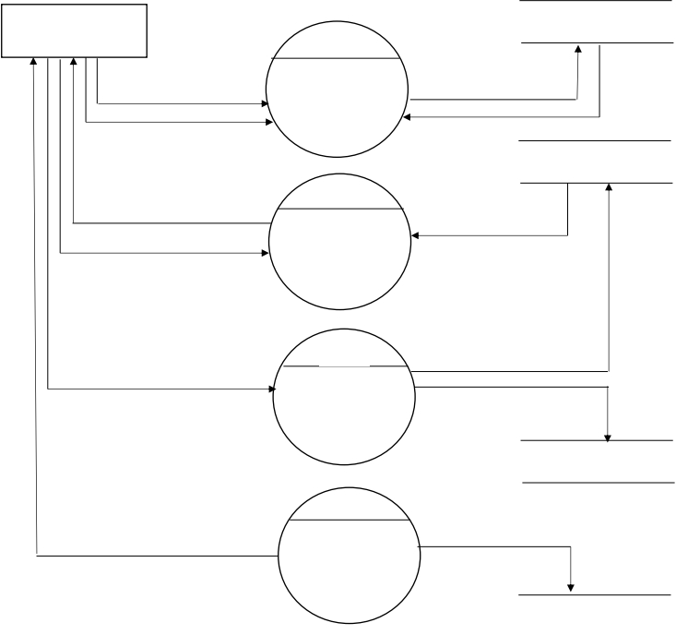
CODEWORK FREELENCER MANAGEMENT SYSTEM
FIRST LEVEL DIAGRAM ADMIN
ADMIN
ADMIN
1.0
ID & Password
Log In
ID & Password
Success & Fail
Success & Fail
FREELANCER
2.0
Freelancer Registration
Freelancer Registration
details
Accept/Denied
Verification
Freelancer
3.0
Manage freelancer
Users Details
Manage
Manage Client
Users
CLIENT
4.0
View Feedback
Feedback
Feedback Details
FEEDBACK
[Date]
3

Slide 4
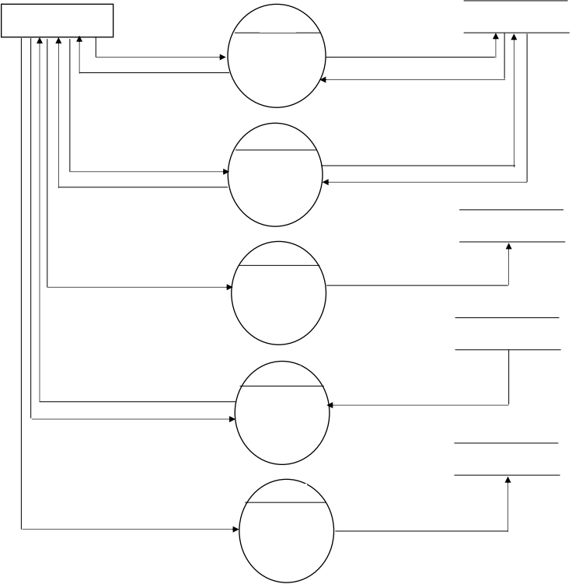
CODEWORK FREELENCER MANAGEMENT SYSTEM
FIRST LEVEL DIAGRAM CLIENT
CLIENT
1.0
CLIENT
Client Details
Registration
Client details
Success & Reject
Success & Reject
2.0
ID & password
Log In
Log In Details
Accept & Reject
Accept & Reject
POST_PRJ
3.0
Post Project
Post
Project Details
REQ_PRJ
4.0
Freelancer Request
Project
Freelanceer Request
Accept & Reject
Request
Verification
FEEDBACK
5.0
Submit Feedback
Feedback
Client Feedback
[Date]
4

